Slide 1

Emerging Technologies
Session #04: An introduction to NodeJS
IBM Bluemix
The Digital Innovation Platform
Sylvain-Roch WILBERT
s_wilbert@fr.ibm.com
Université Paris - Dauphine

Slide 2
Pages on the Web: Reminders
A URL, is a address allowing to identify a ressource and the way to access it on a network. The ”web adress”.
The structure of a URL (Uniform Resource Locator) is as follow
Protocol://Server/Resource
Protocol: The way you want to speak
HTTP : HyperText
FTP: File Transfer
SMB: ServerMessageBlock , …
Server : The location of the resource
Can be a logical name : www.google.fr
Can be a physical name : 216.58.213.35
Can be extended with a PORT to enable several channels of communications on the same adress: for example
www.myserver.fr
www.myserver.fr:8080
Useful to test the same application on different environments or for specific usage (Secure a website )
Default value for http (commonly ommittedin URL) is 80
Resource: The resource your want to access/send

Slide 3
Pages on the Web: Reminders
HTTP (Hypertext Transfer Protocol) is a protocol to enable communications between clients and servers.
It operates a request-response exchange between a client (your browser) and server (the “website”)
2 main types of interactions
GETting a page: You retrieve a resource ( and display its content in a page) from an address
POSTing a page: You send something (the content of the page) to an address

Slide 4
Pages on the Web: Reminders
HTTP hides in pages a return code (in their header) to allow the client (browser) to share the status of the exchange
Most common codes
200 : Sucess;
401 : Unauthentified users;
404 : File not Found;
500 : Server Error.

Slide 5
NodeJS in a nutshell
Node
provides a JavaScript runtime environment
Accessed from a terminal using
node app_name.js
ships with a package management utility called npm, to import third-party libraries into your workspace to use in your code
npm install watson-developer-cloud

Slide 6
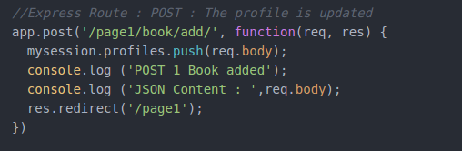
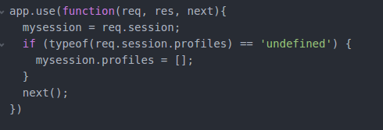
NodeJS in a nutshell
Express
routing and middleware web framework
Routing : Allows to definition of application end points (URIs) and how they respond to client requests
Middleware are functions that have access to the request and response
Execute any code.
Make changes to the request and the response objects.
End the request-response cycle.
Call the next middleware function in the stack.

Slide 7
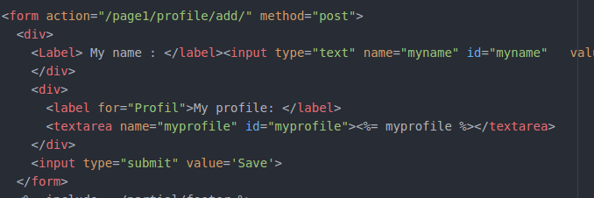
NodeJS in a nutshell
Templates
allow you to split presentation information out from program code
Events-based programming model
Node is a single threaded application enabling the concept of event and callbacks (non blocking strategy)

Slide 8
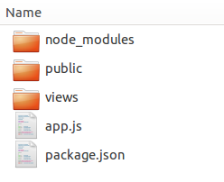
NodeJS in a nutshell
Libraries
Your static files ( logo, stylesheet)
Your templates
Your application (the code…)
Your application description

Slide 9

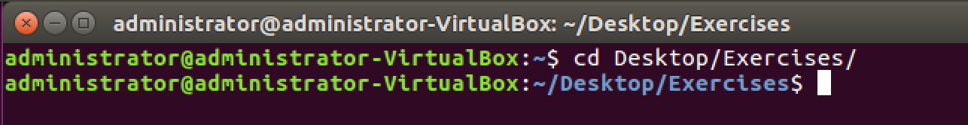
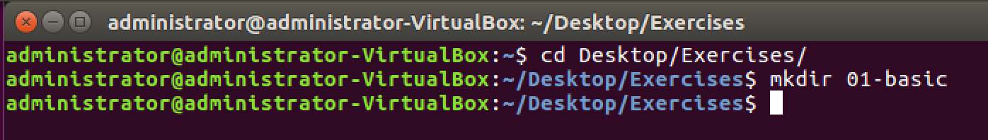
Exercize Directory preparation
Open a terminal
Go to Desktop/Exercises/
Create a directory for the exercize
#1 : mkdir 01-basic
Same principle for all the exercizes

Slide 10

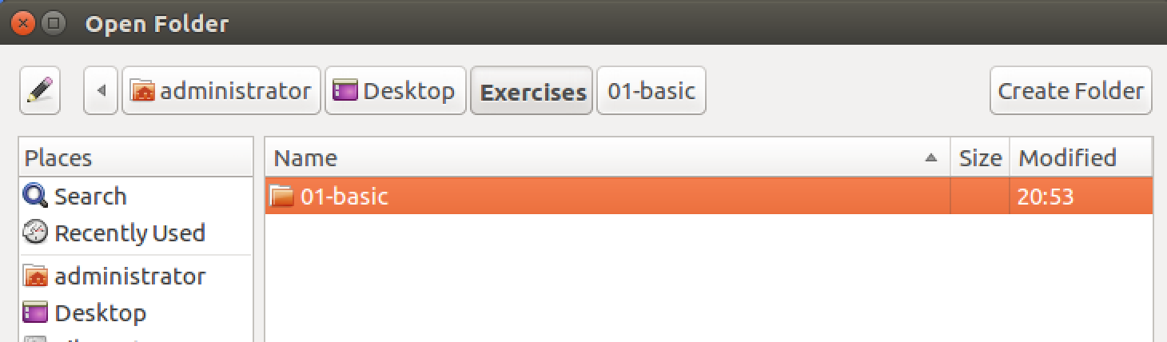
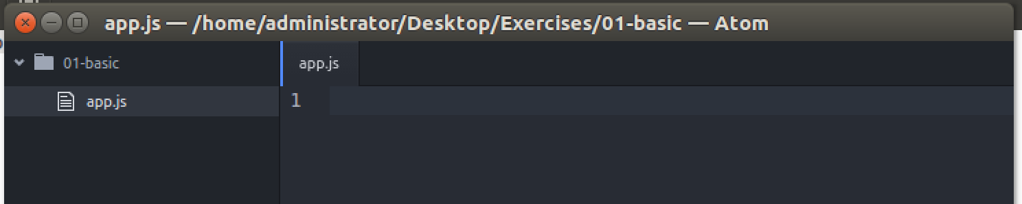
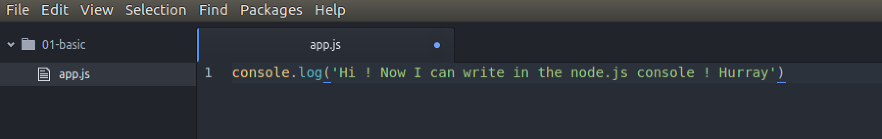
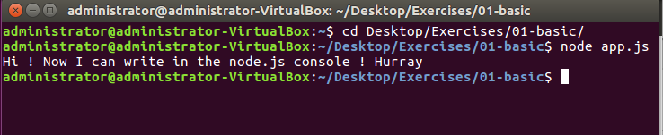
Exercize 01 - NodeJS basics Playing with the console
Open the ATOM IDE
Add the project folder of the exercize
Create new app.js, it appears in the project folder
Add a message to display in the console
Save and run the code from a terminal console, open in the target folder.

Slide 11
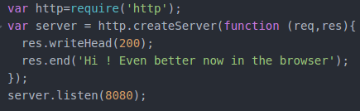
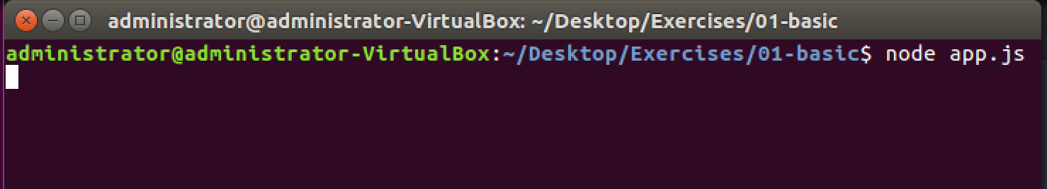
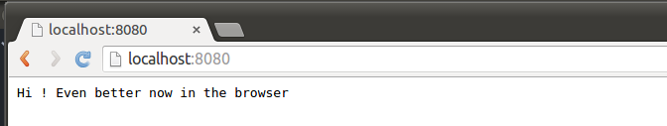
Exercize 02 - NodeJS basics Playing with routes and middlewares, display in the browser
Save and run the code from a terminal console, open in the target folder.
Observe the result in a Web browser page
The http library is required to generate the http server where the page is going to be rendered
Header of the page is generated : HTTP 200 OK
The message is passed to the result page
The server is created on the port 8080

